Slide 1
ANTERPOLATOR
Estimation of spatial values based on
Ant Colony Optimization
Roberto Aguirre Maturana
Geologist – Universidad de Chile
rhaguirrem@gmail.com

Slide 2
ANTERPOLATOR
Numeric interpolator based on Ant Colony Optimization (ACO).
The input is a set of samples with known coordinates
volume occupied by cells is divided by a regular grid with cells of user-defined size.
Each grid cell has 26 neighbor cells, except for cells in the boundaries of the volume.
Each cell with samples has a value assigned equal to the average value of the cells it contains. Cells without samples have no default value assigned.
A number of ants is generated. Each ant has a random starting position corresponding to some of the cells with samples.
Ants generate a prediction for the value of their current cell, as a weighted average value of each neighbor cell.
The prediction is assigned to the current cell (unless it’s a cell with samples).
Options for cell value assignment: If current cell already has a value, it’s replaced by prediction or averaged with prediction. If current cell has no value, either it’s replaced by prediction or averaged with a background value defined by user. In both cases average value has a weight, also user-defined.
After assignment, cells move to a neighbor cell. A cell is considered prioritary if it hasn’t been visited yet by any ant, has no samples or if it’s value is closer to the value of the current cell according to some user-defined tolerance. In case there are no prioritary cells, a random neighbor is chosen.

Slide 3
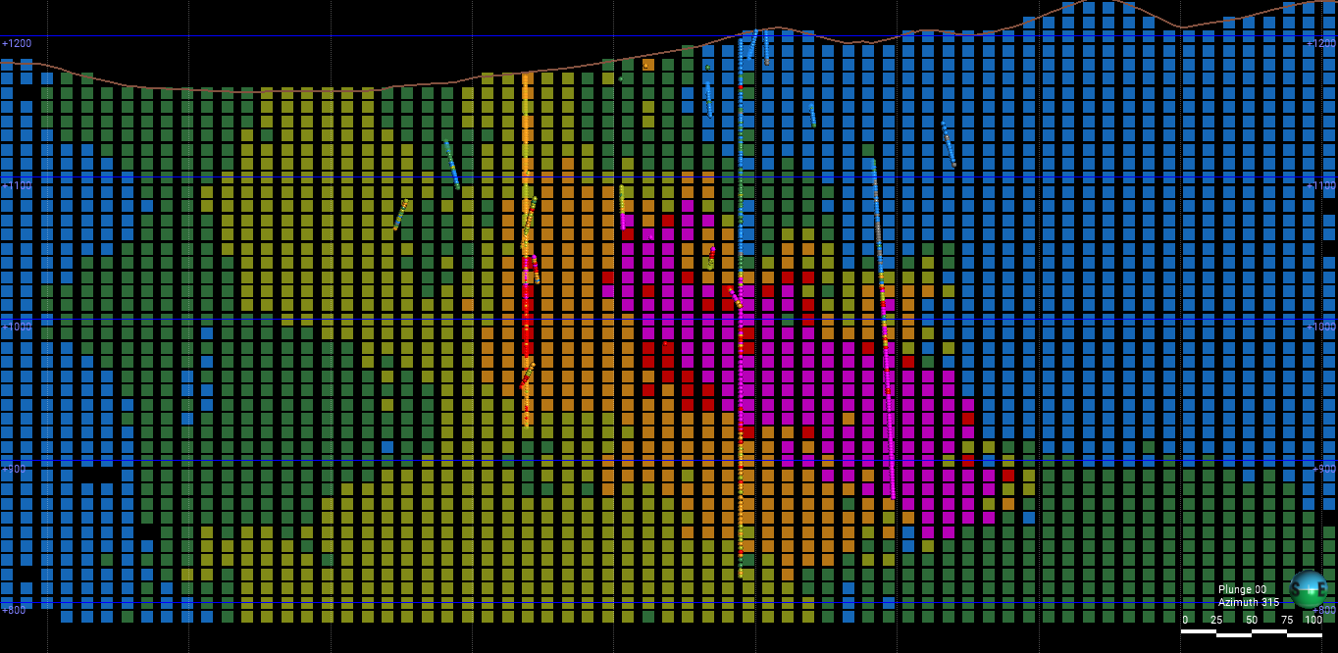
This result was obtained before adding the condition of neighbor cells with first priority for visit not including cells with samples. Notice the isolated drillhole section at the center.
Samples: 27414
Cell Size: 10x10x10
Total cells: 870348
Cells with samples: 6119
Ants: 10000
Class size: 5 - Tolerance: 1
Background value: 0
Iterations: 1000
Cell weight: 0.5
Background Value for None Cells: False
Cells visited: 848558 (97.50%)

Slide 4
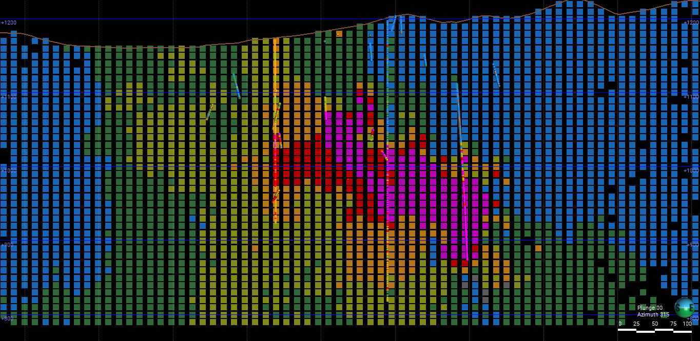
After adding the condition of neighbor cells with first priority for visiting not including cells with samples, continuity of the isogrades increased.
Samples: 27414
Cell Size: 10x10x10
Total cells: 870348
Cells with samples: 6119
Ants: 5000
Class size: 5 - Tolerance: 1
Background value: 0
Iterations: 1000
Cell weight: 0.5
Background Value for None Cells: False
Cells visited: 809246 (92.98%)

Slide 5
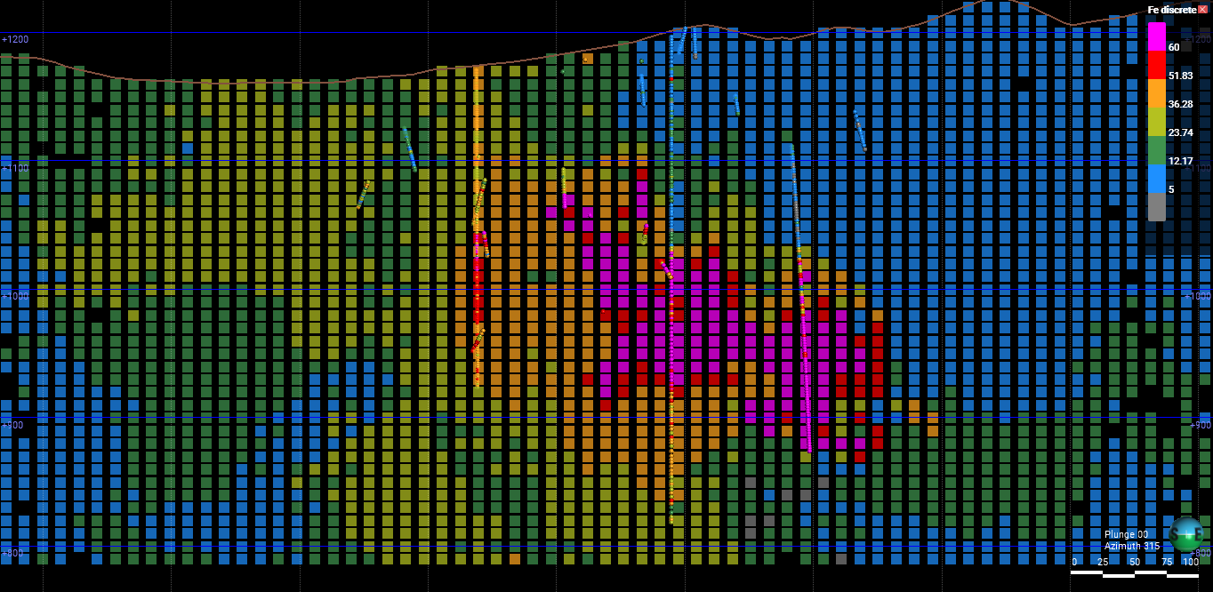
Samples: 27414
Cell Size: 10x10x10
Total cells: 870348
Cells with samples: 6119
Ants: 5000
Class size: 5 - Tolerance: 1
Background value: 0
Iterations: 1000
Cell weight: 0.5
Visit decay lambda: 8
Background value for None cells: False
Cells visited: 808125 (92.85%)

Slide 6
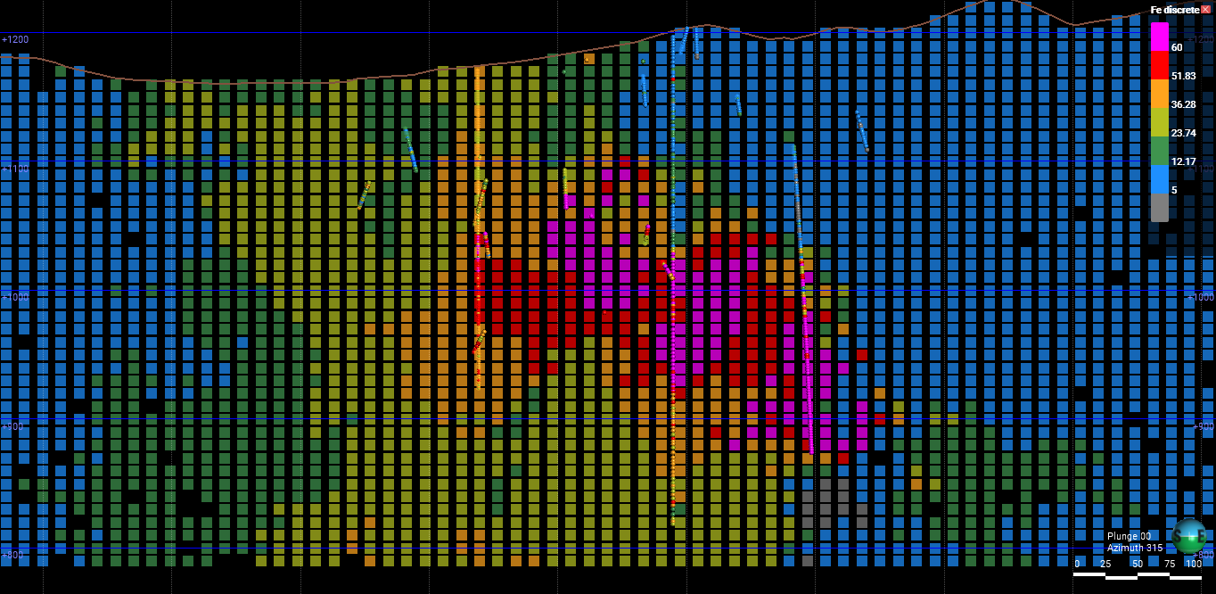
After adding the condition of neighbor cells with first priority for visiting not including cells with samples, continuity of the isogrades increased.
Samples: 27414
Cell Size: 10x10x10
Total cells: 870348
Cells with samples: 6119
Ants: 5000
Class size: 5 - Tolerance: 1
Background value: 0
Iterations: 1000
Cell weight: 0.75
Background Value for None Cells: False
Cells visited: 801554 (92.10%)

Slide 7
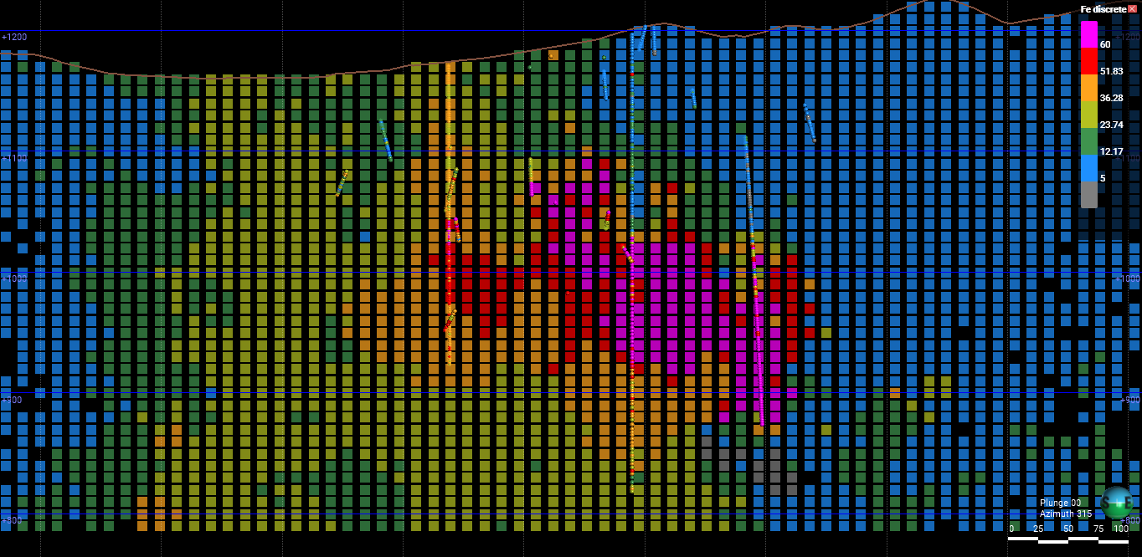
After adding the condition of neighbor cells with first priority for visiting not including cells with samples, continuity of the isogrades increased.
Samples: 27414
Cell Size: 10x10x10
Total cells: 870348
Cells with samples: 6119
Ants: 5000
Class size: 5 - Tolerance: 1
Background value: 0
Iterations: 1000
Cell weight: 0.9
Background Value for None Cells: False
Cells visited: 804983 (92.49%)

Slide 8
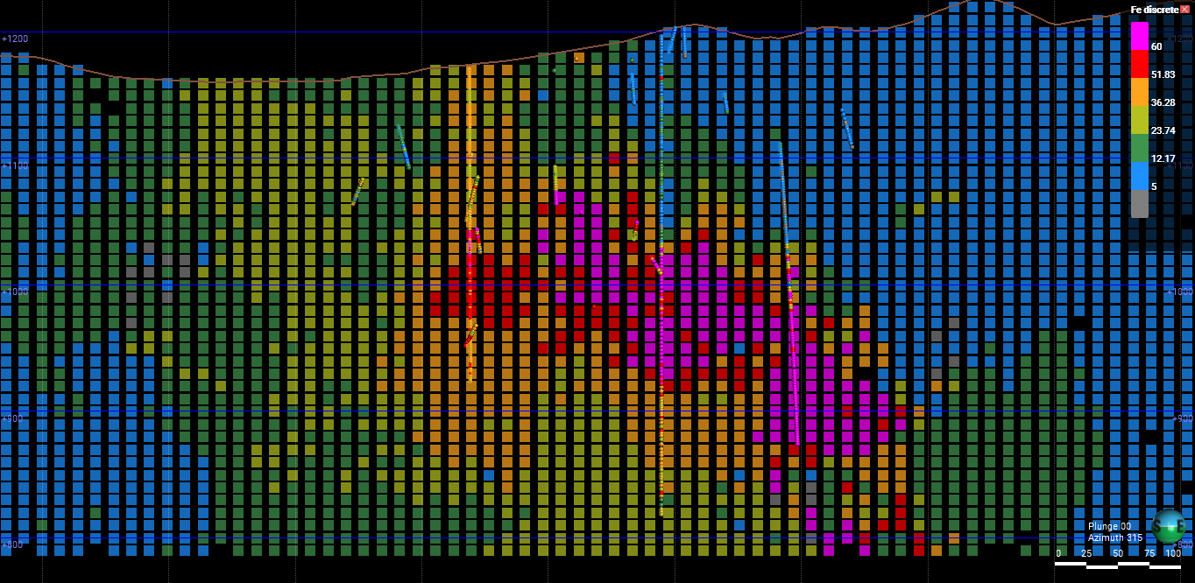
A neighbor cell value is considered close to a cell is the absolute difference between their values is lesser than a threshold defined by the product of the class size and the tolerance. A smaller class size restricts the neighbor cells considered first priority for ant moving.
Samples: 27414
Cell Size: 10x10x10
Total cells: 870348
Cells with samples: 6119
Ants: 5000
Class size: 1 - Tolerance: 1
Background value: 0
Iterations: 1000
Cell weight: 0.5
Decay rate: 64
Background value for None cells: False
Cells visited: 836803 (96.15%)

Slide 9
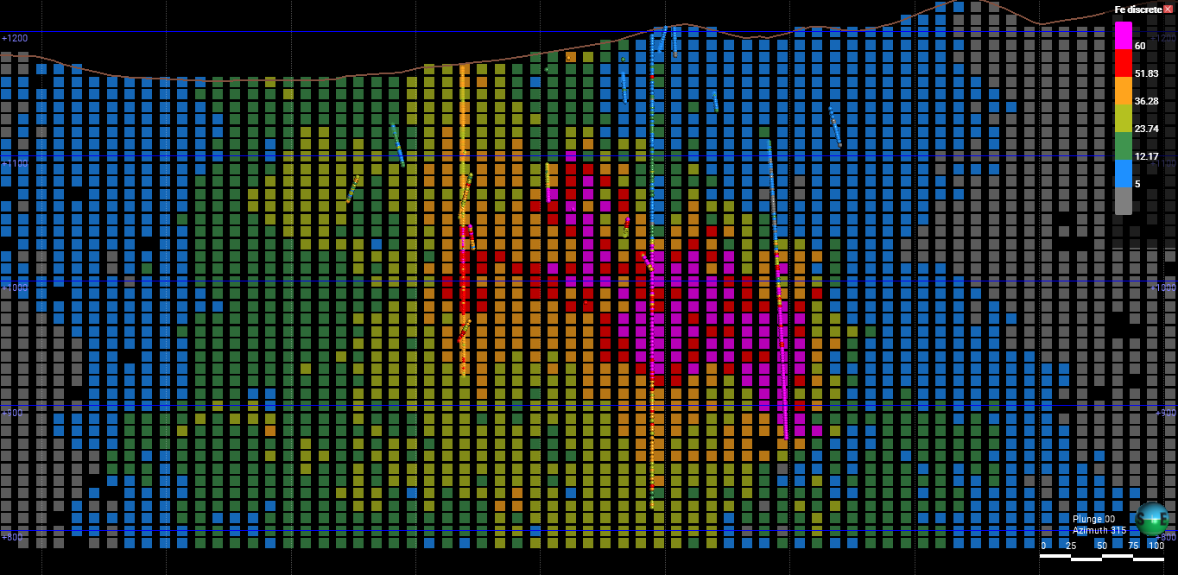
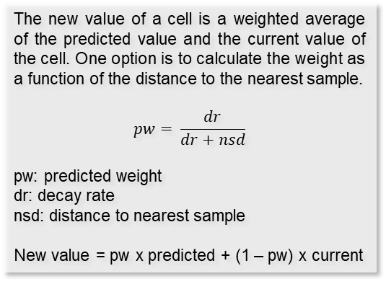
The new value of a cell is a weighted average of the predicted value and the current value of the cell. One option is to calculate the weight as a function of the distance to the nearest sample.
$$pw= \frac{dr}{dr+nsd}$$
pw: predicted weight
dr: decay rate
nsd: distance to nearest sample
New value = pw x predicted + (1 – pw) x current
Samples: 27414
Cell Size: 10x10x10
Total cells: 870348
Cells with samples: 6119
Ants: 5000
Class size: 1 - Tolerance: 1
Background value: 0
Iterations: 1000
Cell weight: None
Decay rate: 1024
Background value for None cells: False
Cells visited: 828246 (95.16%)

Slide 10
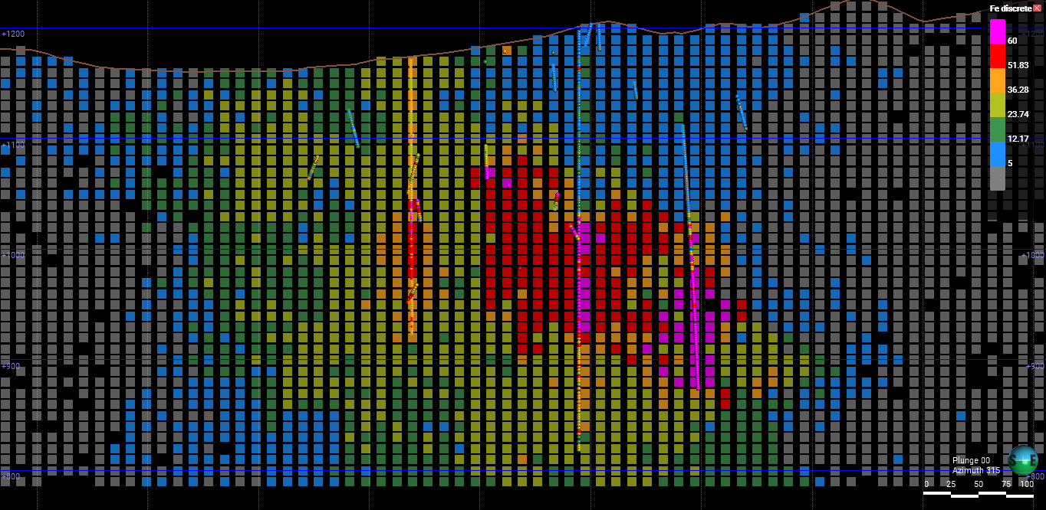
Visit decay lambda purpose is to control how fast the interpolated values converge to background away from samples. Instead of a distance function it’s based on number of visits on each cell.
Samples: 27414
Cell Size: 10x10x10
Total cells: 870348
Cells with samples: 6119
Ants: 5000
Class size: 5 - Tolerance: 1
Background value: 0
Iterations: 1000
Cell weight: 0.9
Visit decay lambda: 4
Background value for None cells: False
Cells visited: 797095 (91.58%)

Slide 11
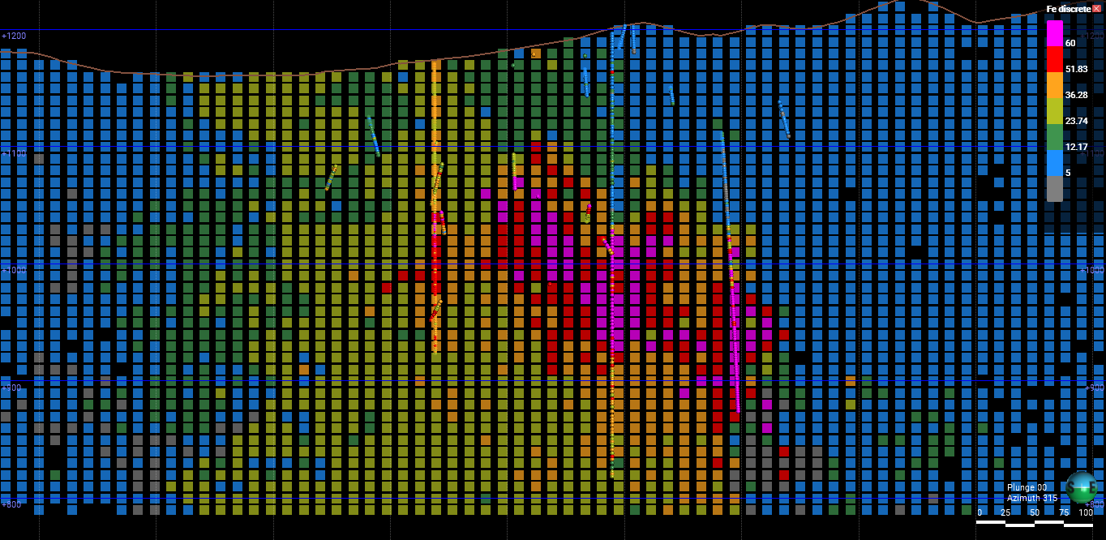
Visit decay lambda doesn’t give enough continuity to close samples, even when values are high enough as to excessively extend the interpolation into areas away from samples.
Samples: 27414
Cell Size: 10x10x10
Total cells: 870348
Cells with samples: 6119
Ants: 5000
Class size: 5 - Tolerance: 1
Background value: 0
Iterations: 1000
Cell weight: 0.9
Visit decay lambda: 8
Background value for None cells: False
Cells visited: 818279 (94.02%)

Slide 12
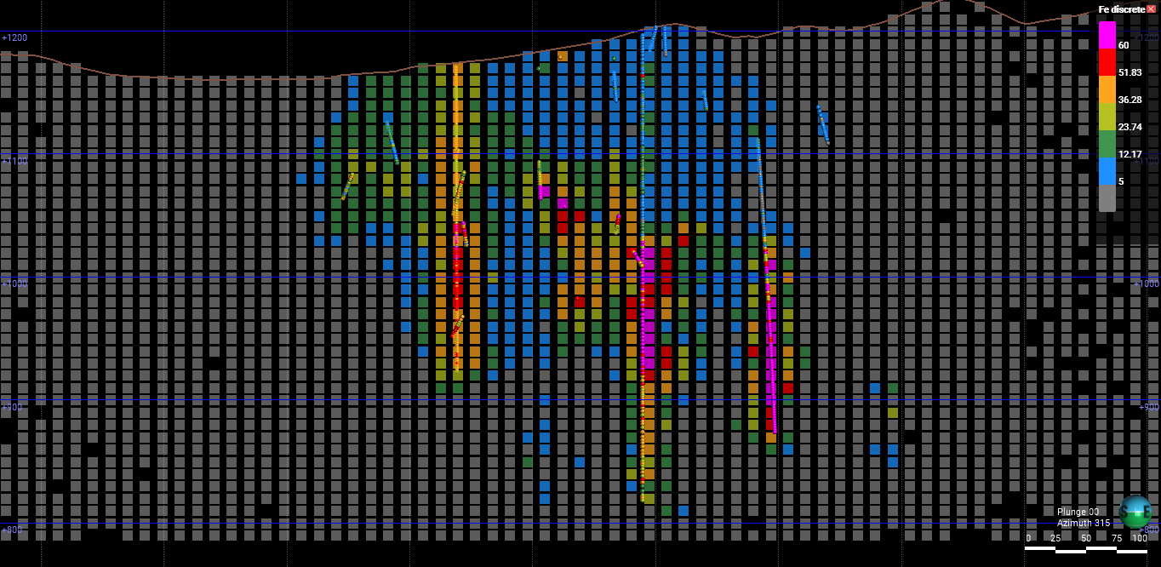
Decay rate controls the influence of distance to samples in the convergence of the interpolation to background value.
Samples: 27414
Cell Size: 10x10x10
Total cells: 870348
Cells with samples: 6119
Ants: 5000
Class size: 5 - Tolerance: 1
Background value: 0
Iterations: 1000
Cell weight: 0.5
Decay rate: 0.1
Background value for None cells: False
Cells visited: 792945 (91.11%)

Slide 13
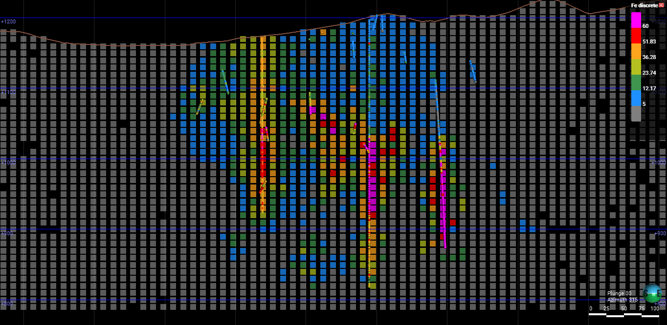
Decay rate controls the influence of distance to samples in the convergence of the interpolation to background value.
Samples: 27414
Cell Size: 10x10x10
Total cells: 870348
Cells with samples: 6119
Ants: 5000
Class size: 5 - Tolerance: 1
Background value: 0
Iterations: 1000
Cell weight: 0.5
Decay rate: 2
Background value for None cells: False
Cells visited: 800446 (91.97%)

Slide 14
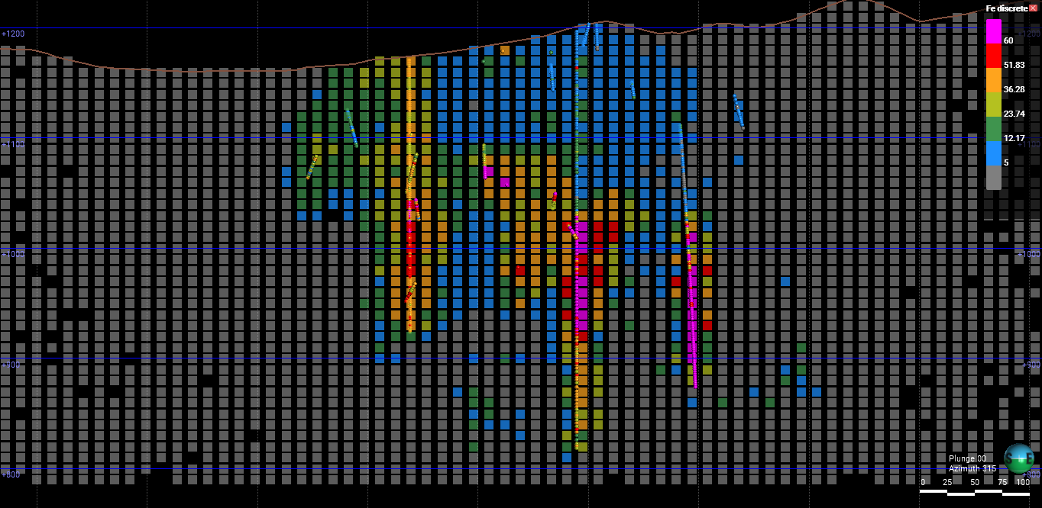
Decay rate controls the influence of distance to samples in the convergence of the interpolation to background value.
Samples: 27414
Cell Size: 10x10x10
Total cells: 870348
Cells with samples: 6119
Ants: 5000
Class size: 5 - Tolerance: 1
Background value: 0
Iterations: 1000
Cell weight: 0.5
Decay rate: 2
Background value for None cells: False
Cells visited: 800446 (91.97%)

Slide 15
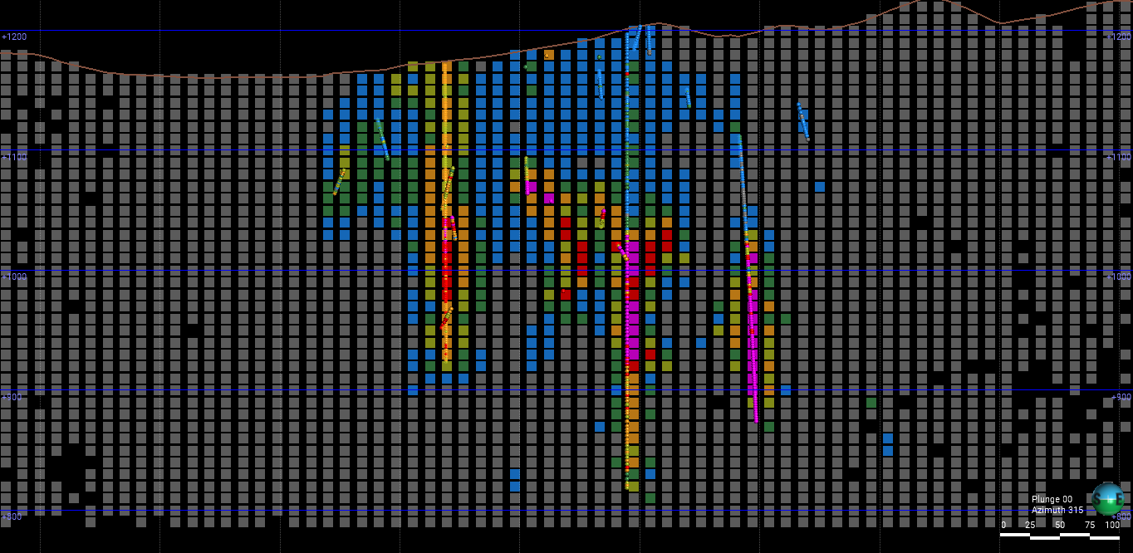
Assuming the background value for first time visited blank cells when averaging with ant prediction based on neighbors makes for a very conservative interpolation.
Samples: 27414
Cell Size: 10x10x10
Total cells: 870348
Cells with samples: 6119
Ants: 5000
Class size: 5 - Tolerance: 1
Background value: 0
Iterations: 1000
Cell weight: 0.5
Background Value for None Cells: True
Cells visited: 786610 (90.38%)

Slide 16
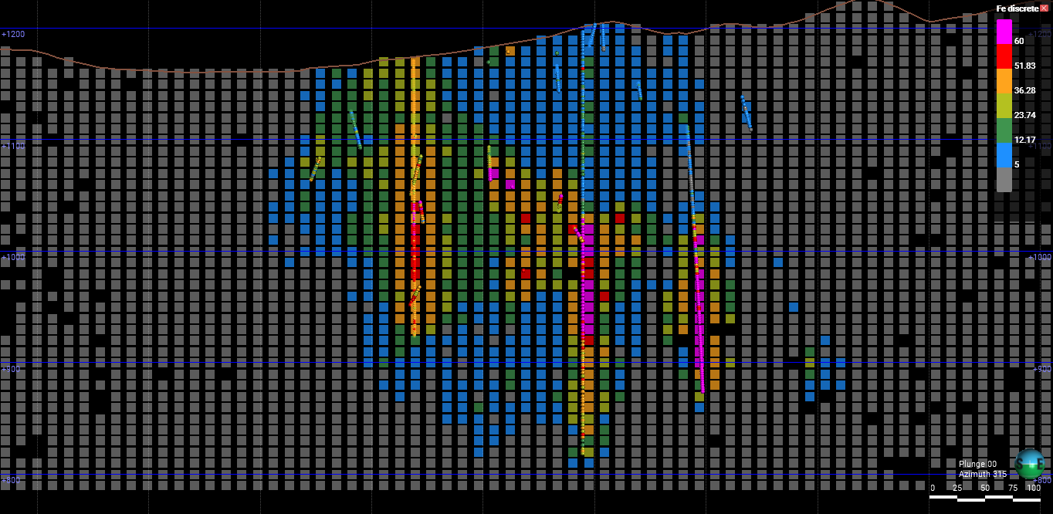
Samples: 27414
Cell Size: 10x10x10
Total cells: 870348
Cells with samples: 6119
Ants: 5000
Class size: 5 - Tolerance: 1
Background value: 0
Iterations: 1000
Cell weight: 0.3
Background Value for None Cells: True
Cells visited: 785662 (90.27%)

Slide 17
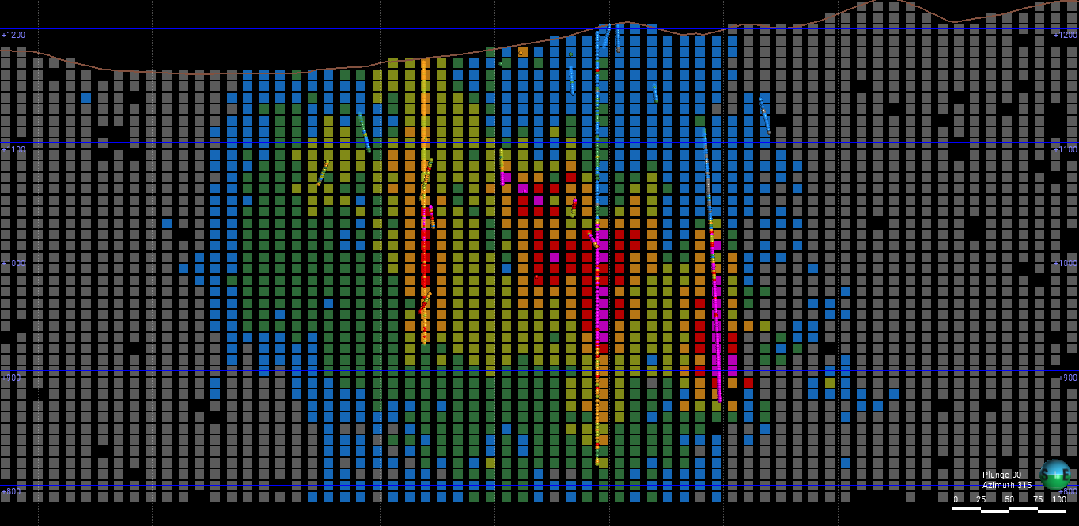
Reducing the cell weight when averaging it with predictions makes for a less conservative estimation, even when background value is assumed for blank cells.
Samples: 27414
Cell Size: 10x10x10
Total cells: 870348
Cells with samples: 6119
Ants: 5000
Class size: 5 - Tolerance: 1
Background value: 0
Iterations: 1000
Cell weight: 0.1
Background Value for None Cells: True
Cells visited: 795747 (91.43%)

Slide 18
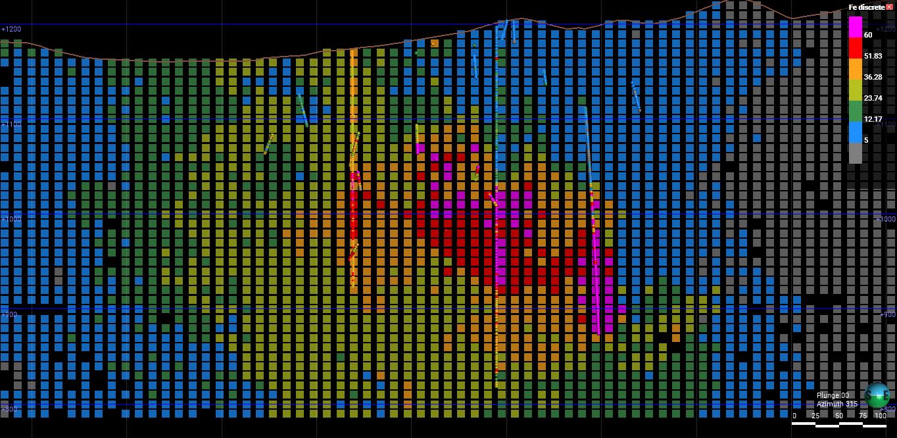
Reducing the cell weight when averaging it with predictions makes for a less conservative estimation, even when background value is assumed for blank cells.
Samples: 27414
Cell Size: 10x10x10
Total cells: 870348
Cells with samples: 6119
Ants: 5000
Class size: 5 - Tolerance: 1
Background value: 0
Iterations: 1000
Cell weight: 0.01
Background Value for None Cells: True
Cells visited: 795975 (91.45%)

Slide 19
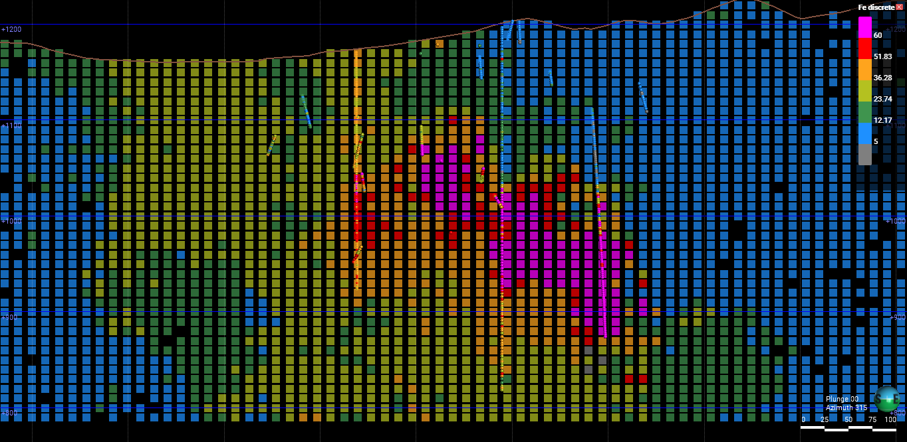
A cell weight of 0 seems to be essentially the same as not using the cell value on the interpolation.
Samples: 27414
Cell Size: 10x10x10
Total cells: 870348
Cells with samples: 6119
Ants: 5000
Class size: 5 - Tolerance: 1
Background value: 0
Iterations: 1000
Cell weight: 0
Background Value for None Cells: True
Cells visited: 803787 (92.35%)

Slide 20
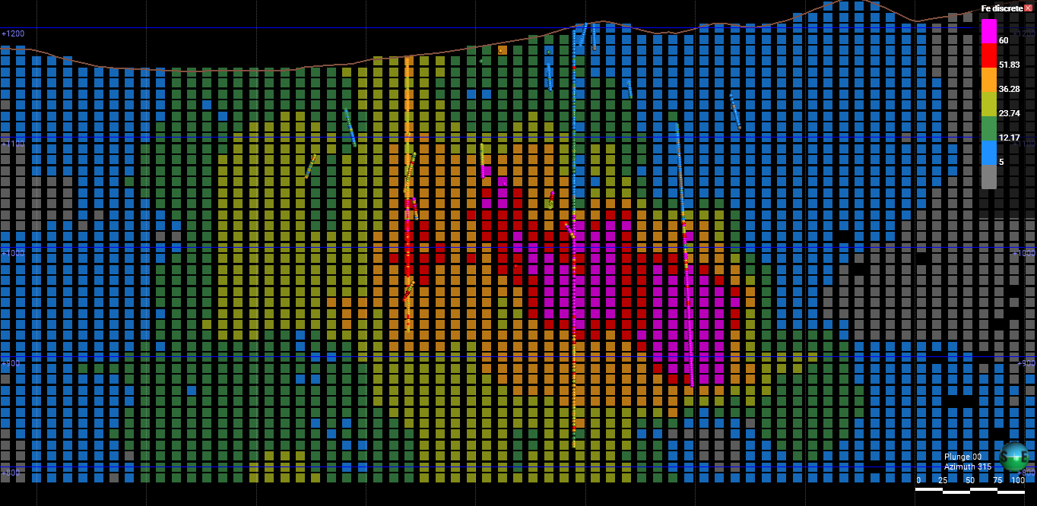
The prediction of a cell value is calculated as a weighted average of the values of the neighbor cells. In this example the weight used is the distance to the nearest sample.
Samples: 27414
Cell Size: 10x10x10
Total cells: 870348
Cells with samples: 6119
Ants: 5000
Class size: 1 - Tolerance: 1
Background value: 0
Iterations: 1000
Cell weight: 0.5
Decay rate: 10
Background value for None cells: False
Cells visited: 841662 (96.70%)

Slide 21
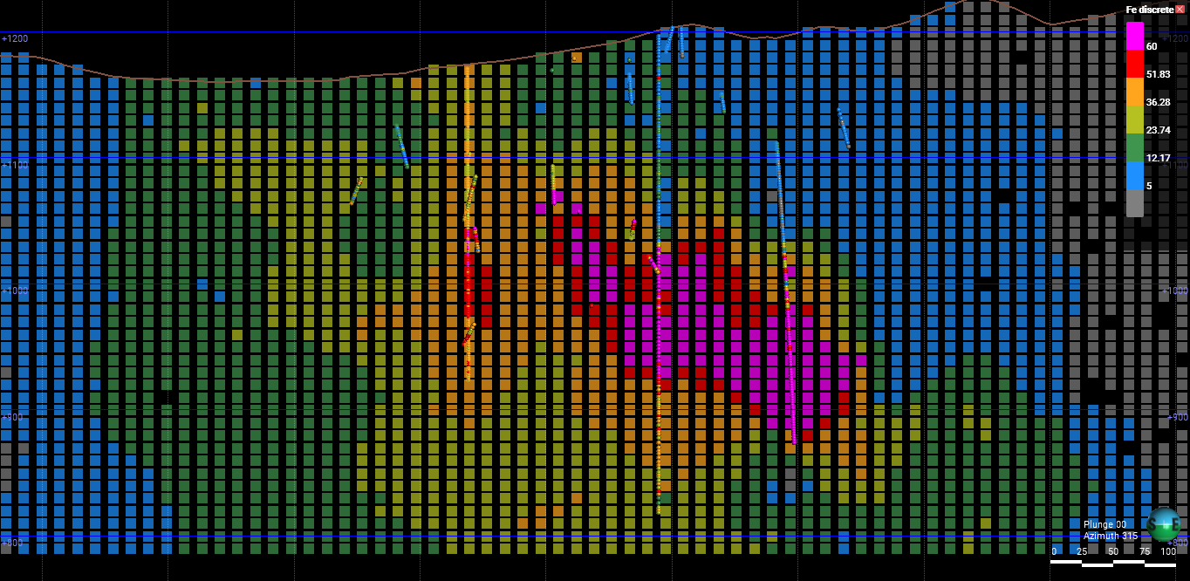
The prediction of a cell value is calculated as a weighted average of the values of the neighbor cells. In this example the weight used is the distance to the nearest sample.
Samples: 27414
Cell Size: 10x10x10
Total cells: 870348
Cells with samples: 6119
Ants: 5000
Class size: 1 - Tolerance: 1
Background value: 0
Iterations: 1000
Cell weight: 0.25
Decay rate: 10
Background value for None cells: False
Cells visited: 838289 (96.32%)

Slide 22
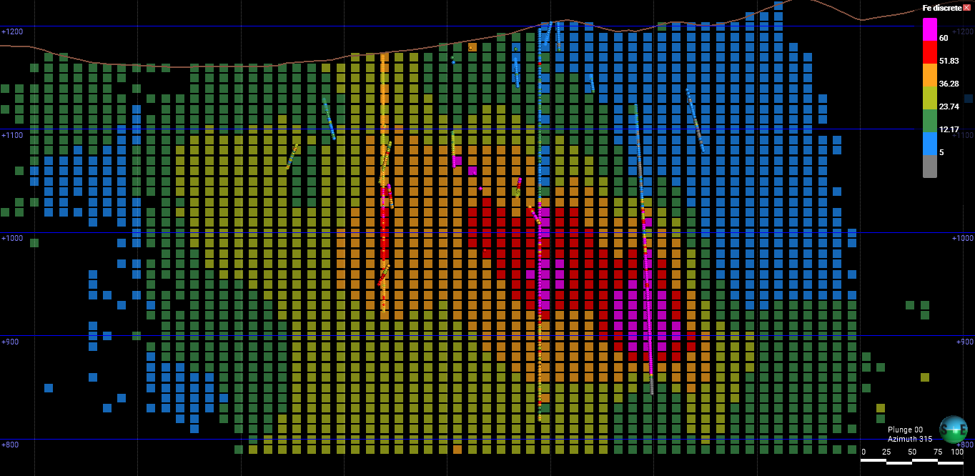
Sample distance range is a parameter that prioritizes moving to cells within a user-defined distance from cells with samples. In this example it was defined as the only first priority parameter. The result is ants remaining closer to samples.
Samples: 27414
Cell Size: 10x10x10
Total cells: 870348
Cells with samples: 6119
Ants: 5000
Class size: 5 - Tolerance: 1
Sample distance range: 10
Background value: 0
Iterations: 1000
Cell weight: 0.5 - Decay rate: None
Background value for None cells: False
Cells visited: 458630 (52.70%)

Slide 23
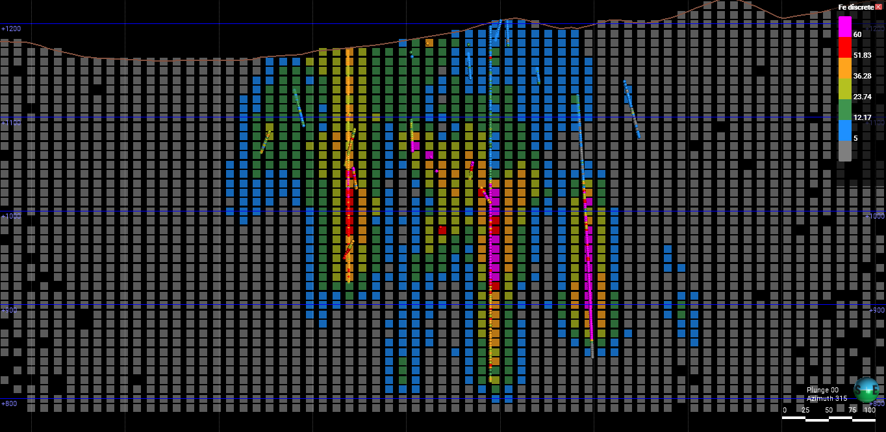
Samples: 27414
Cell Size: 10x10x10
Total cells: 870348
Cells with samples: 6119
Ants: 5000
Class size: 5 - Tolerance: 1
Sample distance range: 5
Background value: 0
Iterations: 1000
Cell weight for post prediction averaging: 0.5 - Decay rate: None
Probability of including cell value during prediction: 1
Background value for None cells: True
Cells visited: 784204 (90.10%)

Slide 24
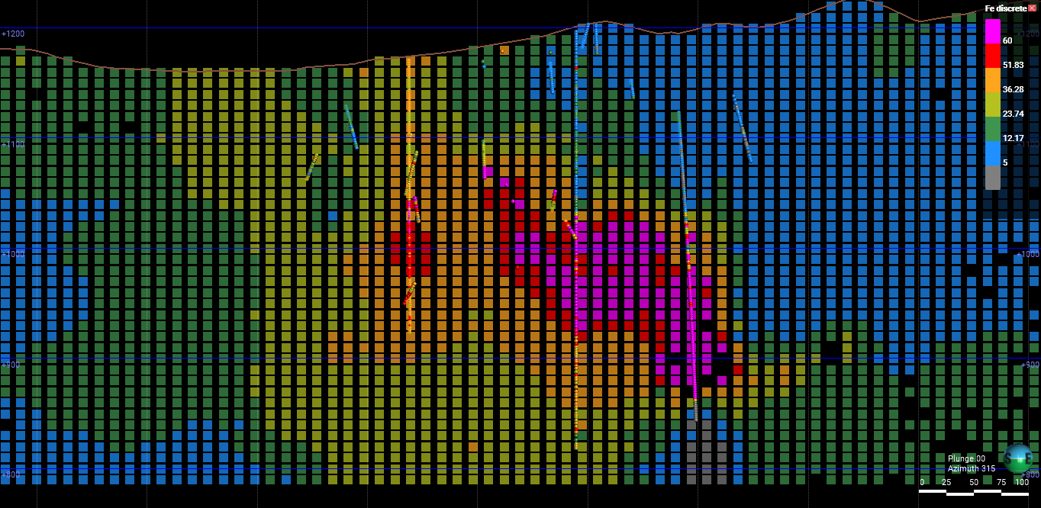
Samples: 27414
Cell Size: 10x10x10
Total cells: 870348
Cells with samples: 6119
Ants: 5000
Class size: 5 - Tolerance: 1
Sample distance range: 5
Background value: 0
Iterations: 500
Cell weight for post prediction averaging: None - Decay rate: None
Probability of including cell value during prediction: 0
Background value for None cells: False
Cells visited: 804652 (92.45%)

Slide 25
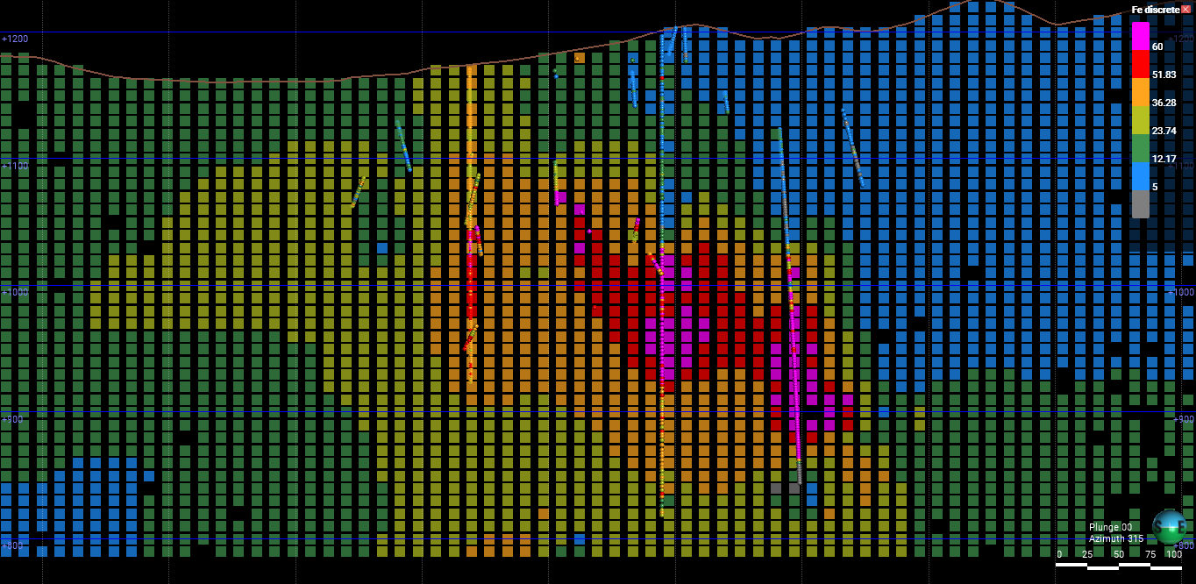
Samples: 27414
Cell Size: 10x10x10
Total cells: 870348
Cells with samples: 6119
Ants: 5000
Class size: 5 - Tolerance: 1
Sample distance range: 5
Background value: 0
Iterations: 1000
Cell weight for post prediction averaging: None - Decay rate: None
Probability of including cell value during prediction: 0
Background value for None cells: True
Cells visited: 800534 (91.98%)

Slide 26
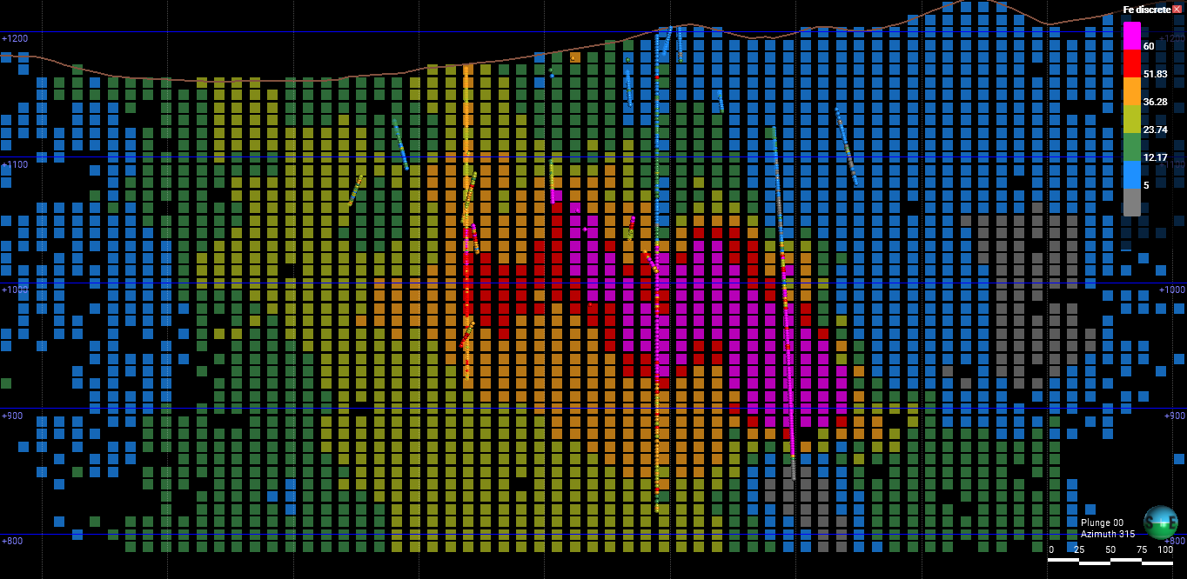
Result after registering for each visited cell the closest sample and using this value for weight calculation during prediction. Less difference between the value of the last visited cell and the cell value of a neighbor cell makes for a biggest weight of that neighbor on interpolation.
Samples: 27414
Cell Size: 10x10x10
Total cells: 870348
Cells with samples: 6119
Ants: 5000
Class size: 5 - Tolerance: 1
Sample distance range: 5
Background value: 0
Iterations: 200
Cell weight for post prediction averaging: None - Decay rate: None
Probability of including cell value during prediction: 0
Background value for None cells: False
Cells visited: 632218 (72.64%)

Slide 27
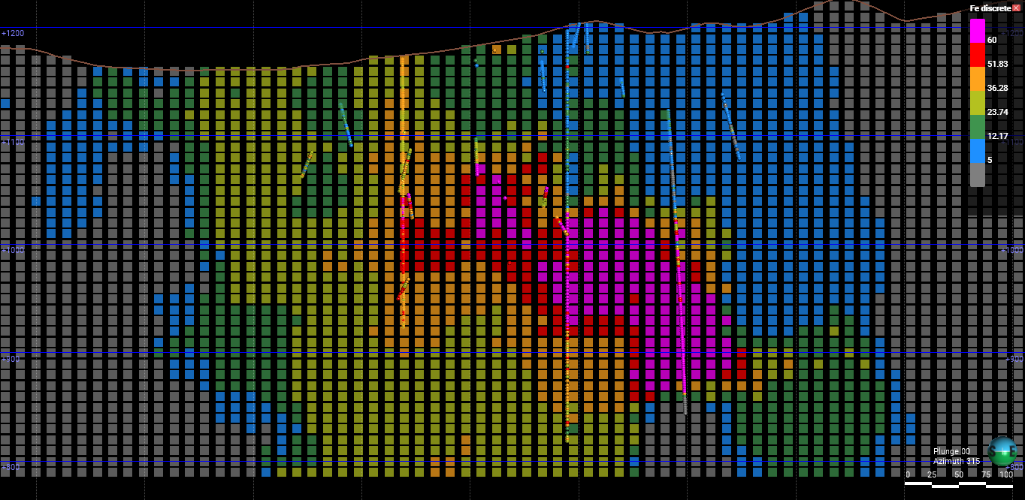
Sample distance range is a parameter used to control the extension of the anomaly by assuming background value for None cells beyond a certain distance form the nearest cell with samples. Non-visited cells were filled using the average value of their neighbors.
Samples: 27414
Cell Size: 10x10x10
Total cells: 870348
Cells with samples: 6119
Ants: 5000
Class size: 2 - Tolerance: 1
Sample distance range: 10
Background value: 0
Iterations: 200
Decay rate: None
Probability of including cell value during prediction: 0
Background value for None cells: True
Fill unvisited cells with neighbors average: True
Cells visited: 665928 (76.51%)

Slide 28
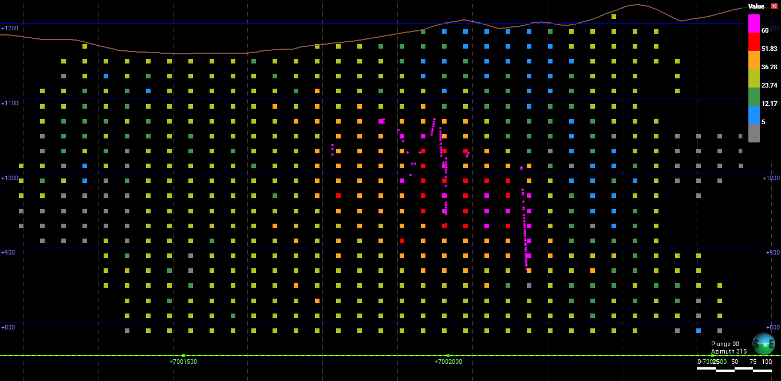
Samples: 27414
Cell Size: 20x20x20
Total cells: 110577
Cells with samples: 2974
Starting ants: 8922 - Surviving ants: 8922
Max pheromone: 150
Class size: 2 - Tolerance: 1
Domain average distance: 7 - Background distance: 10
Background value: 0
Decay rate: 1
Probability of including cell value during prediction: 0
Value for None cells: True
Weight method: greater_sample
Fill unvisited cells with neighbors average: False
Iterations: 20
Cells visited: 78125 (70.65%)

Slide 29
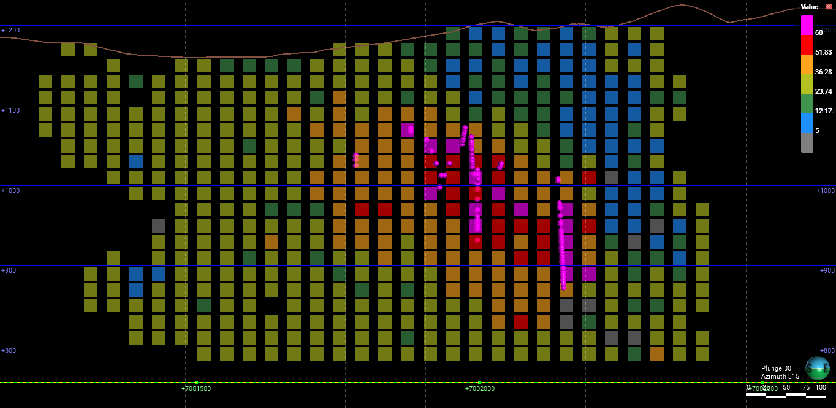
Samples: 27414
Cell Size: 20x20x20
Total cells: 110577
Cells with samples: 2974
Starting ants: 8922 - Surviving ants: 8922
Max pheromone: 150
Class size: 2 - Tolerance: 1
Domain average distance: 7 - Background distance: 10
Background value: 0
Decay rate: 1
Probability of including cell value during prediction: 0
Value for None cells: True
Weight method: greater_sample
Fill unvisited cells with neighbors average: False
Iterations: 10
Cells visited: 63549 (57.47%)

Slide 30
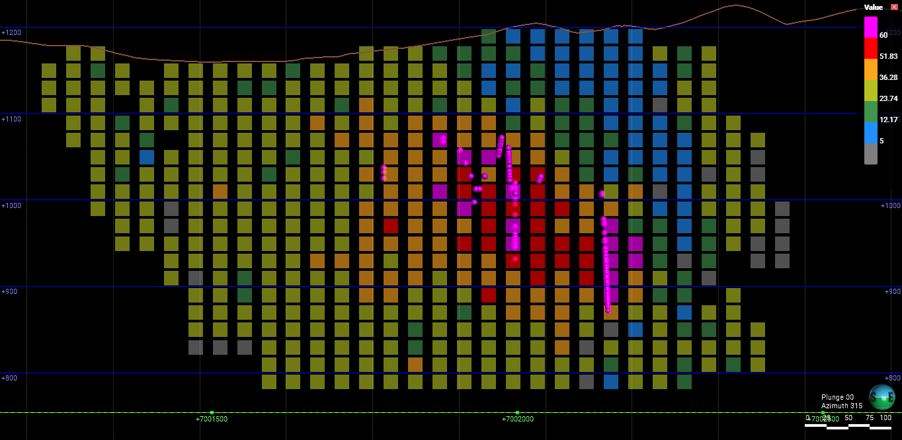
Samples: 27414
Cell Size: 20x20x20
Total cells: 110577
Cells with samples: 2974
Starting ants: 8922 - Surviving ants: 8922
Max pheromone: 150
Class size: 2 - Tolerance: 1
Domain average distance: 7 - Background distance: 10
Background value: 0
Decay rate: 0.5
Probability of including cell value during prediction: 0
Value for None cells: True
Weight method: greater_sample
Fill unvisited cells with neighbors average: False
Iterations: 10
Cells visited: 63845 (57.74%)

Slide 31
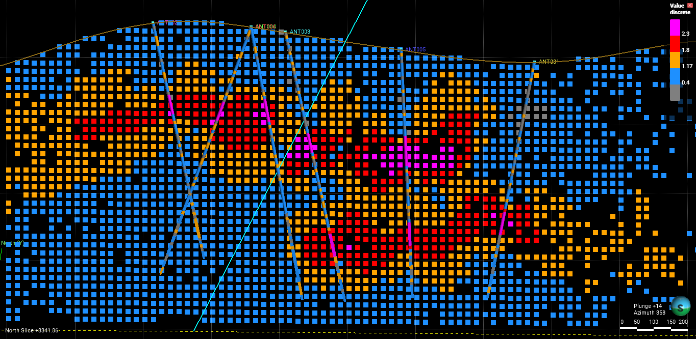
In this example a fault divides de boundary in two domains. In this case, the criteria for priority considers that the direction from current cell to neighbor is the same as the direction from last cell to current, and neighbor cell sharing the same mark of class. weight is based on cell value, Greater value means greater wieight.
Samples: 468
Cell Size: 25x25x25
Total cells: 229320
Cells with samples: 241
Ants: 723
Class size: 0.2 - Tolerance: 1
Domain average distance: 100 - Background distance: 10
Background value: 0
Decay rate: 2
Probability of including cell value during prediction: 0
Value for None cells: True
Weight method: greater_value
Fill unvisited cells with neighbors average: False
Iterations: 200
Cells visited: 188276 (82.10%)

Slide 32
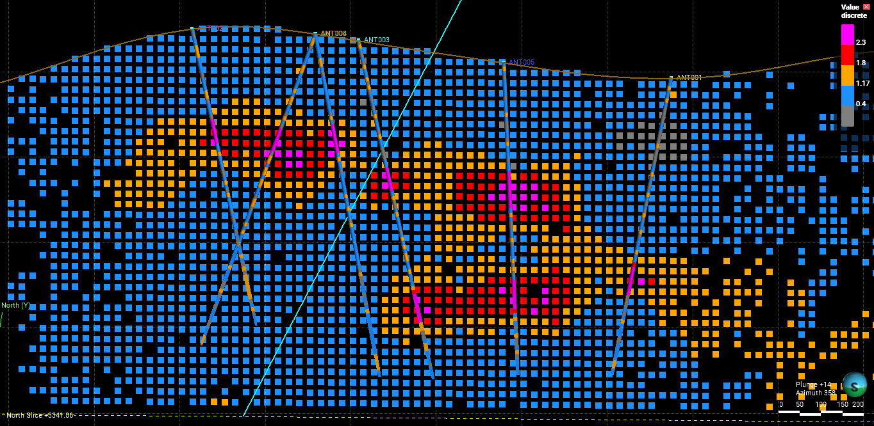
In this example a fault divides de boundary in two domains. In this case, the criteria for priority considers that the direction from current cell to neighbor is the same as the direction from last cell to current, and neighbor cell sharing the same mark of class. weight is based on cell value, Greater value means greater wieight.
Samples: 468
Cell Size: 25x25x25
Total cells: 229320
Cells with samples: 241
Ants: 723
Class size: 0.2 - Tolerance: 1
Domain average distance: 100 - Background distance: 10
Background value: 0
Decay rate: 0.5
Probability of including cell value during prediction: 0
Value for None cells: True
Weight method: greater_value
Fill unvisited cells with neighbors average: False
Iterations: 200
Cells visited: 187348 (81.70%)

Slide 33
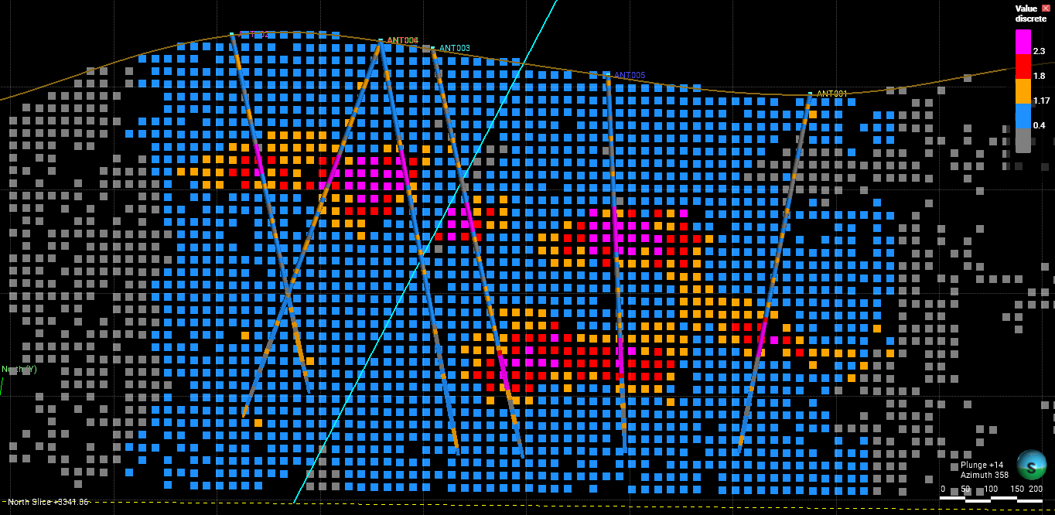
In this example a fault divides de boundary in two domains. In this case, the criteria for priority considers that the direction from current cell to neighbor is the same as the direction from last cell to current, and neighbor cell sharing the same mark of class. Weight is based on nearest sample. The closer to a sample means the greater the weight.
Samples: 468
Cell Size: 25x25x25
Total cells: 229320
Cells with samples: 241
Ants: 723
Class size: 0.2 - Tolerance: 1
Domain average distance: 100 - Background distance: 10
Background value: 0
Decay rate: 2
Probability of including cell value during prediction: 0
Value for None cells: True
Weight method: nearest_sample
Fill unvisited cells with neighbors average: False
Iterations: 200
Cells visited: 188276 (82.10%)

Slide 34
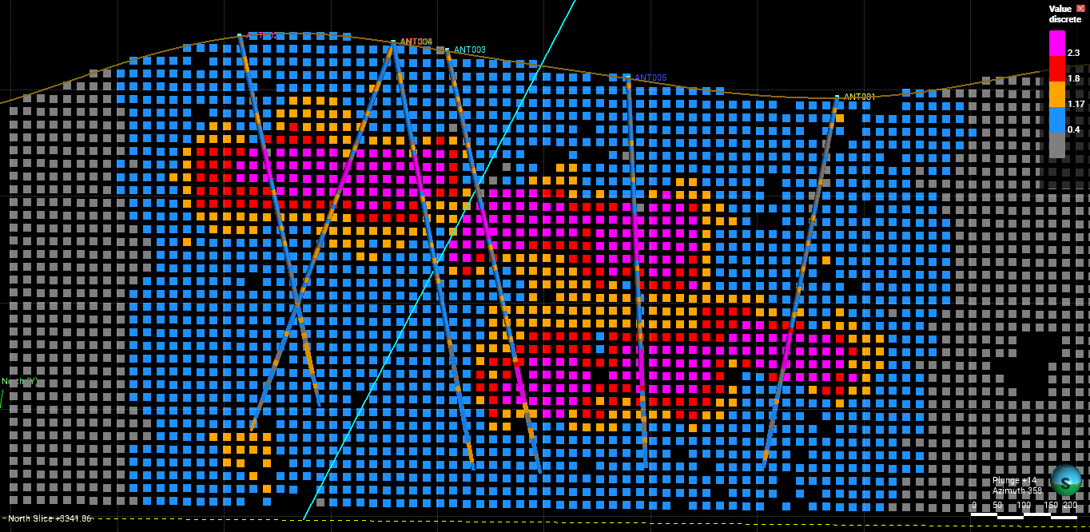
In this example a fault divides de boundary in two domains. Weight is based on value of the closest sample. The greater the value of the closest sample the greater the weight.
Samples: 468
Cell Size: 25x25x25
Total cells: 229320
Cells with samples: 241
Ants: 723
Class size: 0.2 - Tolerance: 1
Domain average distance: 7 - Background distance: 10
Background value: 0
Decay rate: 1.5
Probability of including cell value during prediction: 0
Value for None cells: True
Weight method: greater_sample
Fill unvisited cells with neighbors average: False
Iterations: 200
Cells visited: 224511 (82.93%)

Slide 35
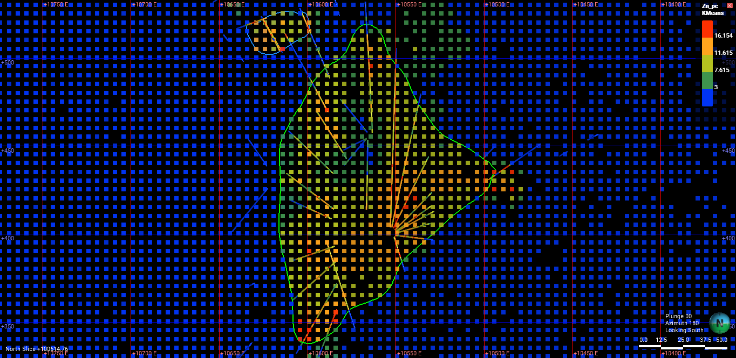
Domained estimation.
Currently, the formula for weighting of neighbor cells is:
fValue = get_mark_of_class(abs(last_cell.closest_sample - cell.value), self.class_size)
weight = self.class_size/(self.class_size + fValue ** self.decay_rate)
Samples: 21908
Cell Size: 5x5x5
Total cells: 3726450
Cells with samples: 1077347
Ants: 3000
Class size: 1 - Tolerance: 1
Sample distance range: 10
Background value: 0
Decay rate: 0.5
Probability of including cell value during prediction: 0
Background value for None cells: True
Fill unvisited cells with neighbors average: False
Iterations: 500
Cells visited: 1301637 (34.93%)

Slide 36
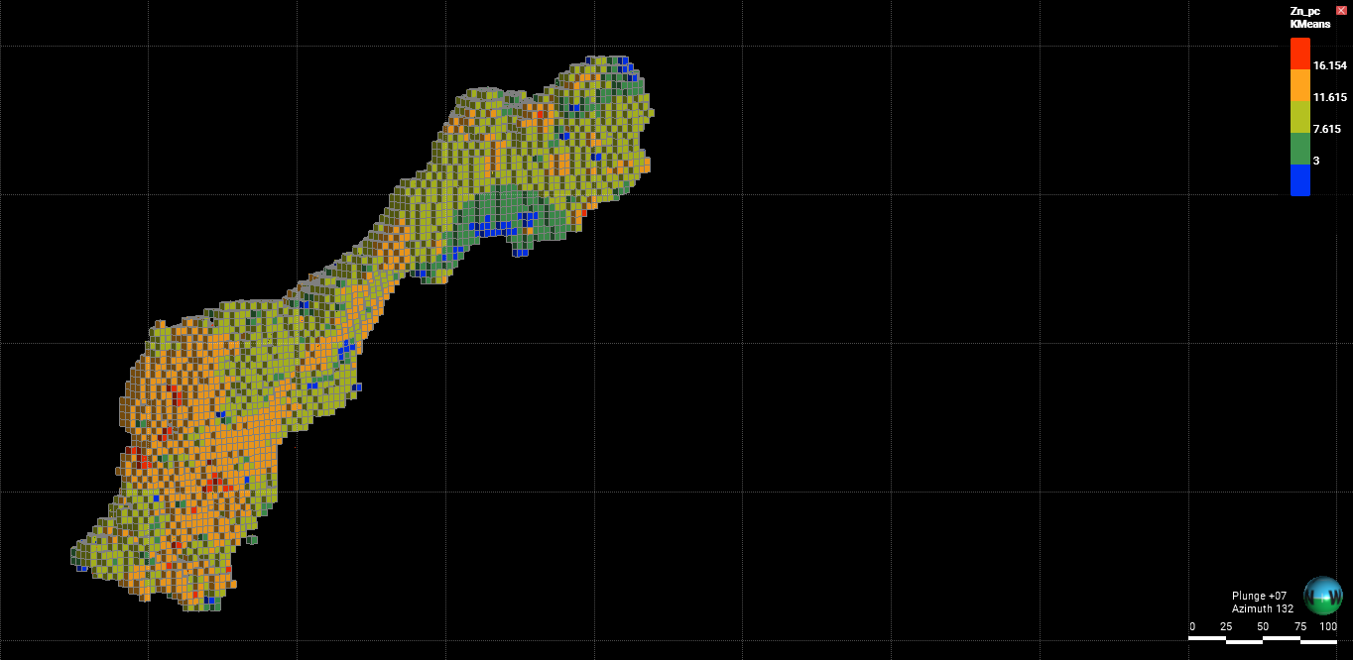
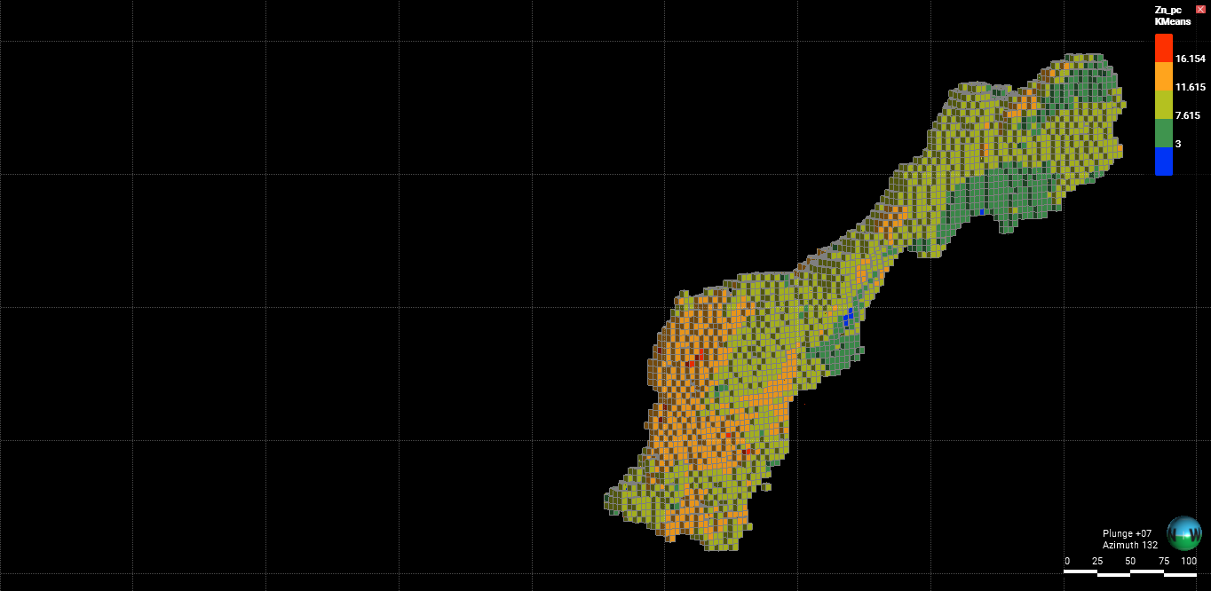
Anterpolator
Kriging

Slide 37
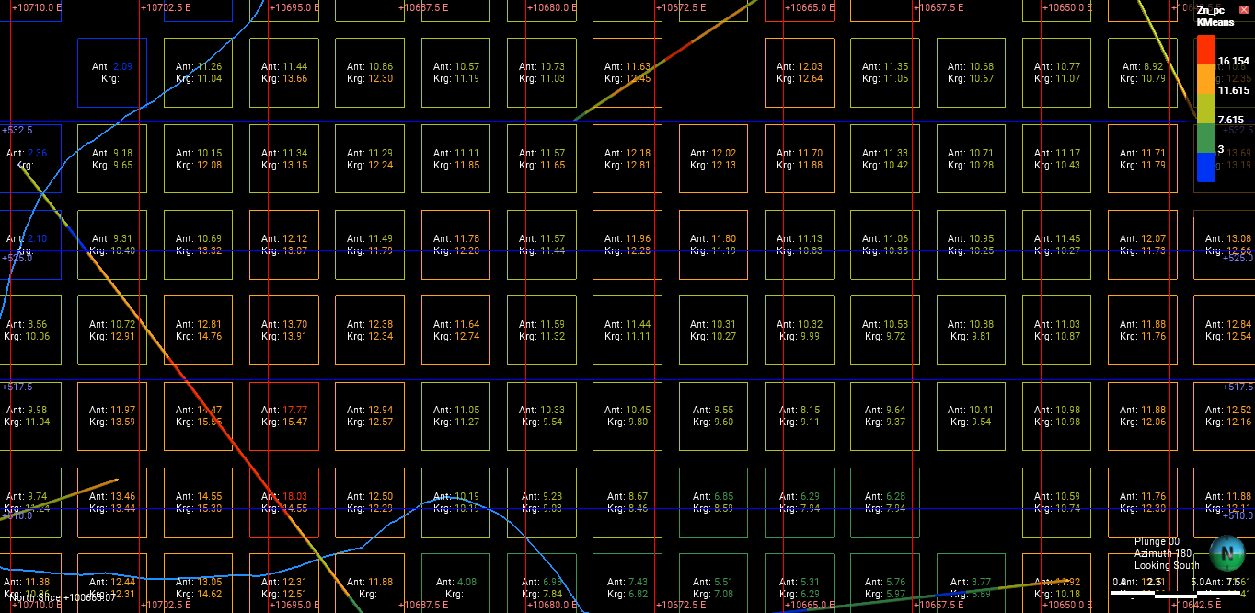
Comparison of Anterpolator and Kriging
Samples: 21908
Cell Size: 5x5x5
Total cells: 3726450
Cells with samples: 1077347
Ants: 3000
Class size: 1 - Tolerance: 1
Sample distance range: 10
Background value: 0
Decay rate: 0.5
Probability of including cell value during prediction: 0
Background value for None cells: True
Fill unvisited cells with neighbors average: False
Iterations: 500
Cells visited: 1301637 (34.93%)

Slide 38
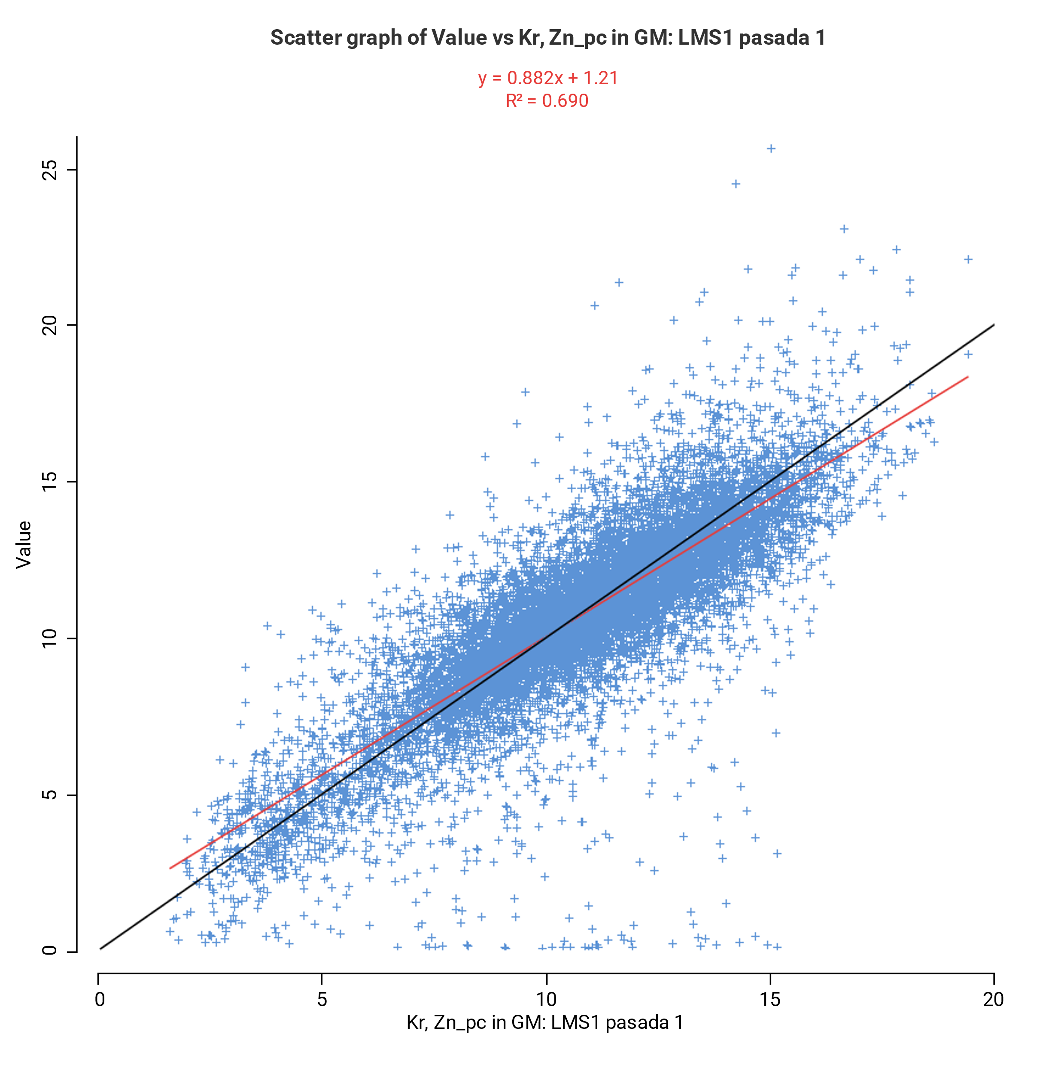
Comparison of Anterpolator and Kriging
Samples: 21908
Cell Size: 5x5x5
Total cells: 3726450
Cells with samples: 1077347
Ants: 3000
Class size: 1 - Tolerance: 1
Sample distance range: 10
Background value: 0
Decay rate: 0.5
Probability of including cell value during prediction: 0
Background value for None cells: True
Fill unvisited cells with neighbors average: False
Iterations: 500
Cells visited: 1301637 (34.93%)

Slide 39
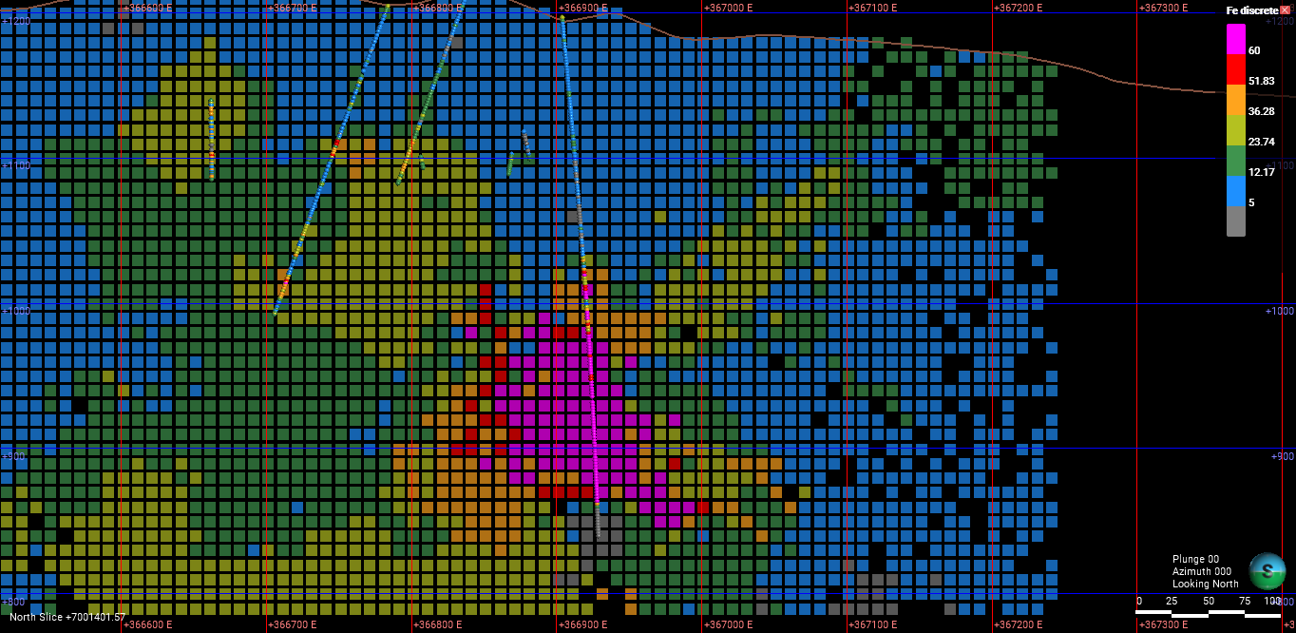
Samples: 27414
Cell Size: 10x10x10
Total cells: 870348
Cells with samples: 6119
Ants: 10000
Class size: 5 - Tolerance: 1
Background value: 0
Iterations: 500
Cell weight: 0.5
Background Value for None Cells: False
Cells visited: 720366 (82.77%)

Slide 40
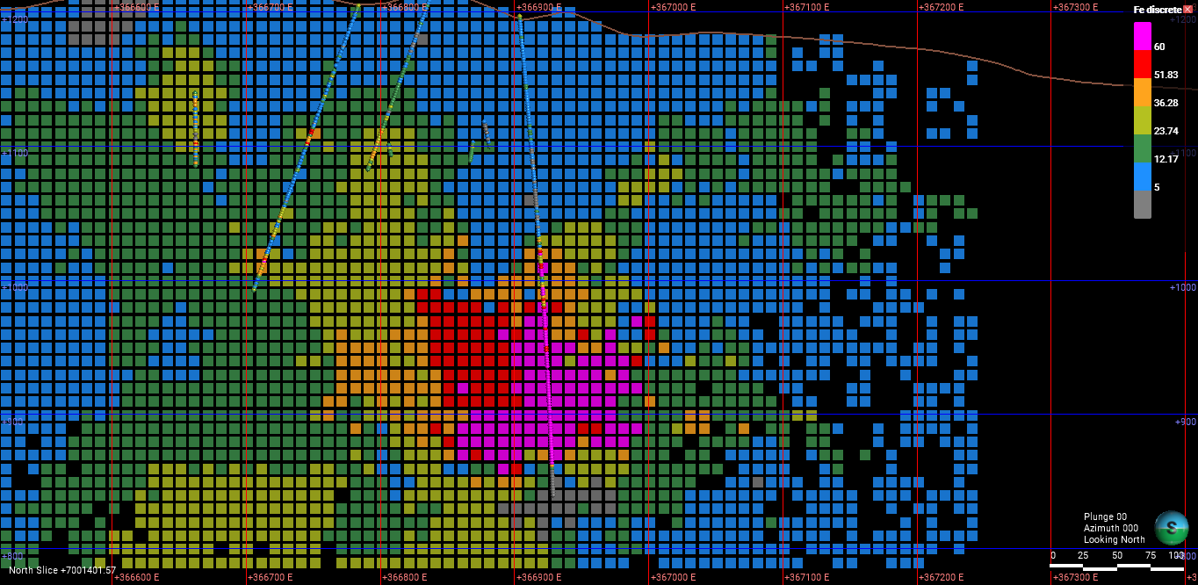
Samples: 27414
Cell Size: 10x10x10
Total cells: 870348
Cells with samples: 6119
Ants: 20000
Class size: 5 - Tolerance: 1
Background value: 0
Iterations: 250
Cell weight: 0.5
Background Value for None Cells: False
Cells visited: 613422 (70.48%)

Slide 41
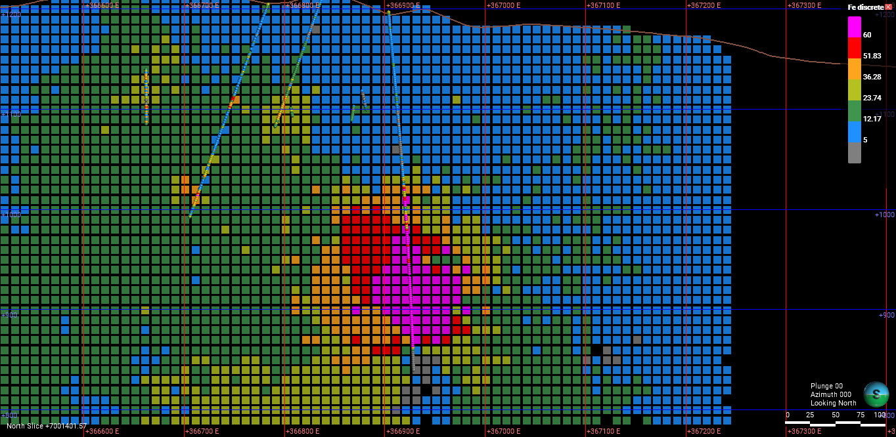
Samples: 27414
Cell Size: 10x10x10
Total cells: 870348
Cells with samples: 6119
Ants: 10000
Class size: 5 - Tolerance: 1
Background value: 0
Iterations: 1000
Cell weight: 0
Background Value for None Cells: False
Cells visited: 849198 (97.57%)

Slide 42
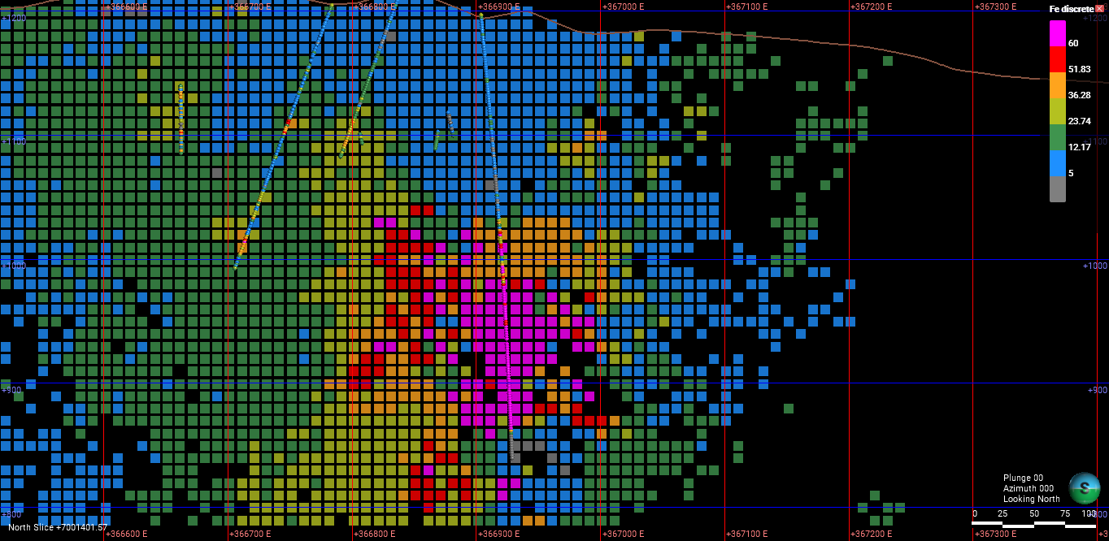
Samples: 27414
Cell Size: 10x10x10
Total cells: 870348
Cells with samples: 6119
Ants: 10000
Class size: 5 - Tolerance: 1
Background value: 0
Iterations: 200
Cell weight: 0
Background Value for None Cells: False
Cells visited: 461938 (53.08%)

Slide 43
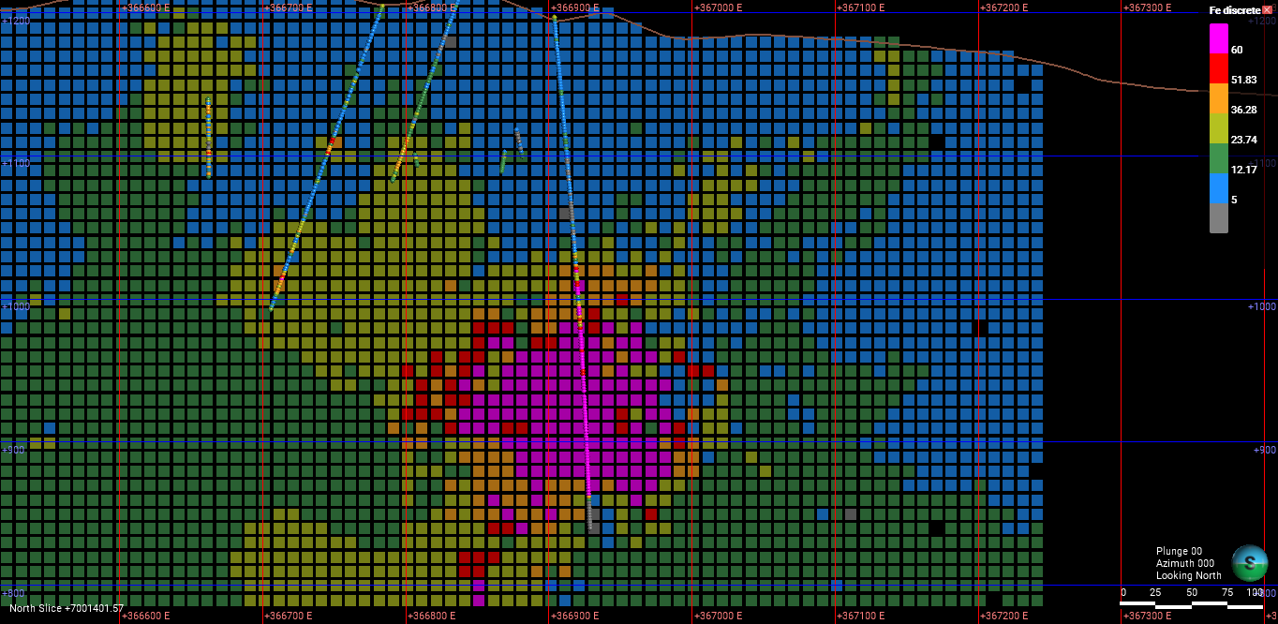
Samples: 27414
Cell Size: 10x10x10
Total cells: 870348
Cells with samples: 6119
Ants: 10000
Class size: 5 - Tolerance: 1
Background value: 0
Iterations: 1000
Cell weight: 0.5
Background Value for None Cells: False
Cells visited: 848558 (97.50%)

Slide 44
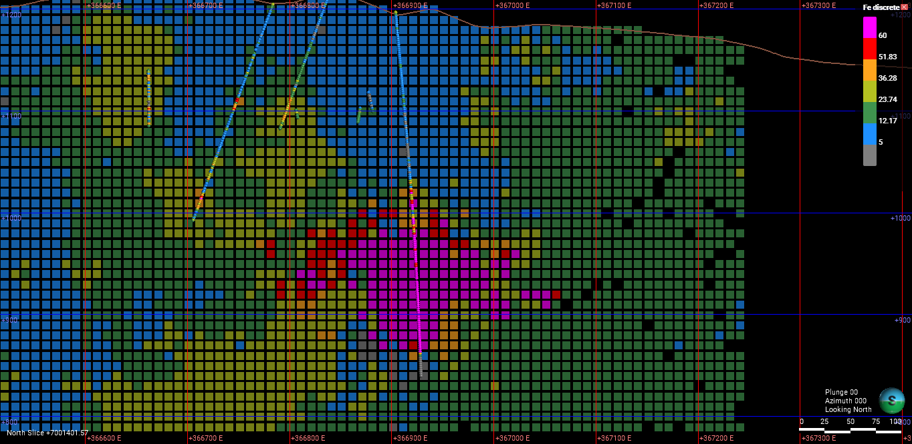
Samples: 27414
Cell Size: 10x10x10
Total cells: 870348
Cells with samples: 6119
Ants: 5000
Class size: 5 - Tolerance: 1
Background value: 0
Iterations: 1000
Cell weight: 0.5
Background Value for None Cells: False
Cells visited: 809246 (92.98%)

Slide 45
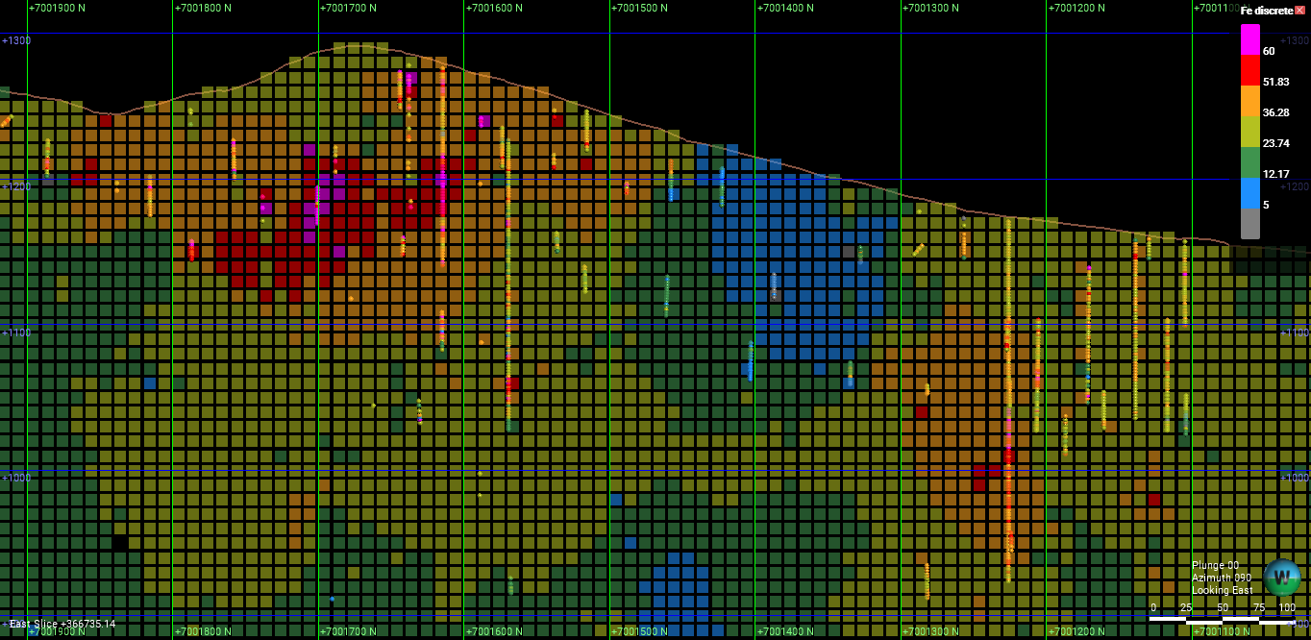
Samples: 27414
Cell Size: 10x10x10
Total cells: 870348
Cells with samples: 6119
Ants: 10000
Class size: 5 - Tolerance: 1
Background value: 0
Iterations: 500
Cell weight: 0.5
Background Value for None Cells: False
Cells visited: 720366 (82.77%)

Slide 46
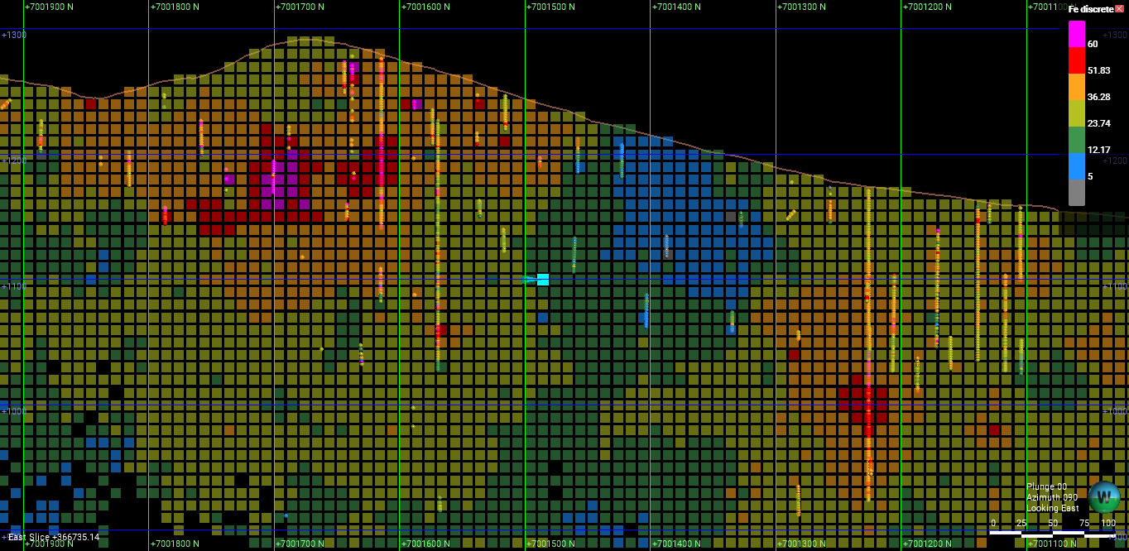
Samples: 27414
Cell Size: 10x10x10
Total cells: 870348
Cells with samples: 6119
Ants: 20000
Class size: 5 - Tolerance: 1
Background value: 0
Iterations: 100
Cell weight: 0.5
Background Value for None Cells: False
Cells visited: 394875 (45.37%)

Slide 47
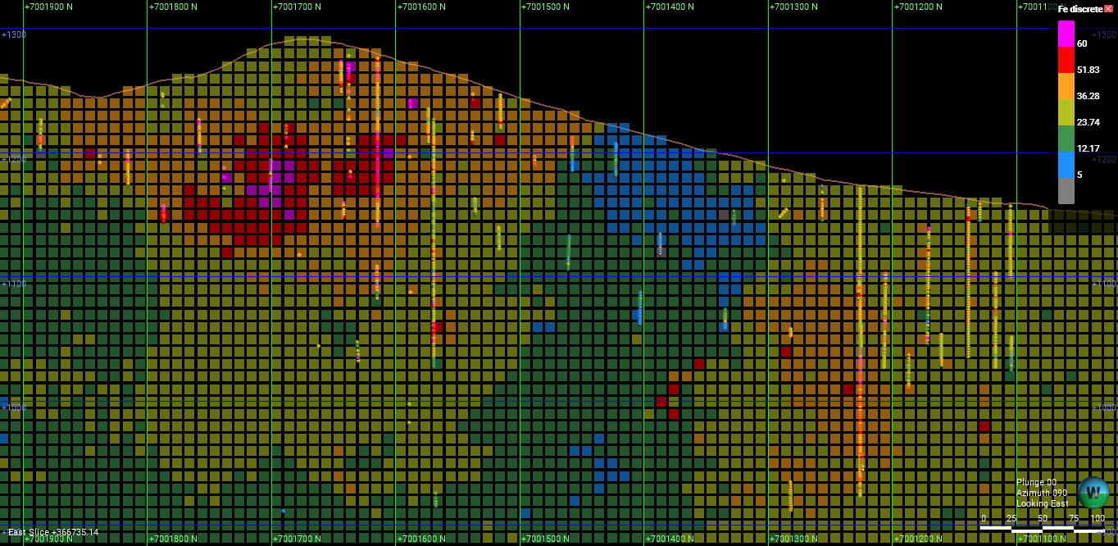
Samples: 27414
Cell Size: 10x10x10
Total cells: 870348
Cells with samples: 6119
Ants: 10000
Class size: 5 - Tolerance: 1
Background value: 0
Iterations: 1000
Cell weight: 0
Background Value for None Cells: False
Cells visited: 849198 (97.57%)

Slide 48
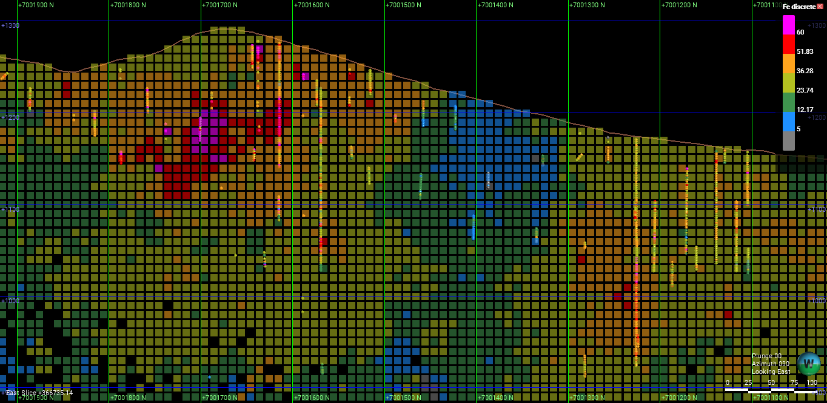
Samples: 27414
Cell Size: 10x10x10
Total cells: 870348
Cells with samples: 6119
Ants: 10000
Class size: 5 - Tolerance: 1
Background value: 0
Iterations: 200
Cell weight: 0
Background Value for None Cells: False
Cells visited: 461938 (53.08%)

Slide 49
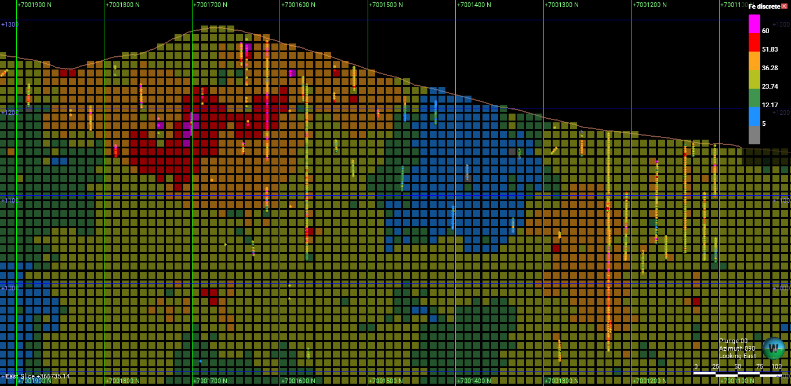
Samples: 27414
Cell Size: 10x10x10
Total cells: 870348
Cells with samples: 6119
Ants: 10000
Class size: 5 - Tolerance: 1
Background value: 0
Iterations: 1000
Cell weight: 0.5
Background Value for None Cells: False
Cells visited: 848558 (97.50%)

Slide 50
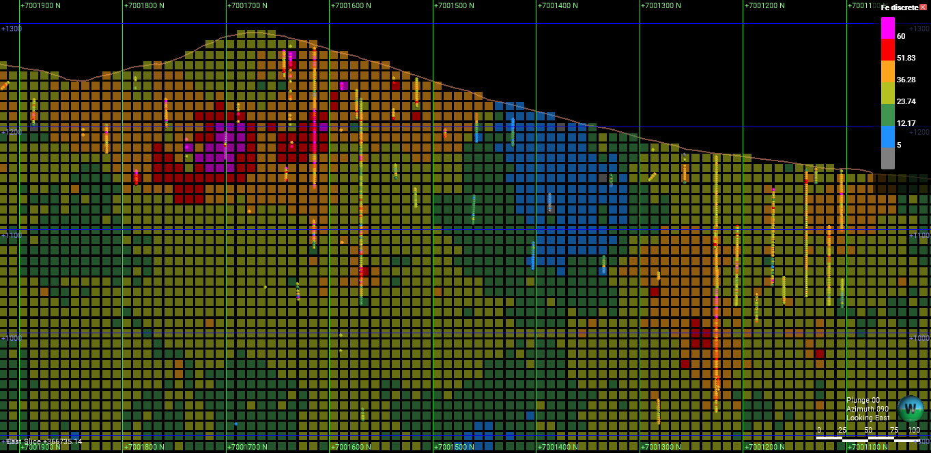
Samples: 27414
Cell Size: 10x10x10
Total cells: 870348
Cells with samples: 6119
Ants: 5000
Class size: 5 - Tolerance: 1
Background value: 0
Iterations: 1000
Cell weight: 0.5
Background Value for None Cells: False
Cells visited: 809246 (92.98%)

